Slide 1
GUVI Capstone Project YouTube Data Harvesting and Warehousing using SQL and Streamlit
Name: Jaysri Saravanan
Course: Data Science
Batch: MDT32

Slide 2
Introduction
YouTube is one of the largest video-sharing platforms, with billions of active users worldwide. The platform serves as a primary source of entertainment, education, and marketing.
With the rise of digital content, more creators and brands are turning to YouTube to reach their audiences. This makes understanding and analyzing YouTube data crucial for success.
In the competitive landscape of YouTube, data-driven decisions are essential. Analyzing channel performance, audience engagement, and video trends helps creators optimize content strategy and improve audience retention.

Slide 3
Objective
To develop an application that retrieves YouTube channel data directly from the YouTube API.
To securely store the harvested data in a MySQL database, enabling efficient data management and access for analysis.
To create an intuitive Streamlit-based interface where users can easily input a YouTube channel ID and retrieve relevant data.
To implement a feature that allows users to upload the retrieved YouTube data directly to the MySQL database.
To enable users to perform customized queries on the stored data through a dropdown menu in the Streamlit app, allowing them to extract specific insights such as top-performing videos or channel growth trends.

Slide 4
Technology Stack
Tools and Technologies:
Streamlit: For creating the web interface.
YouTube API: For retrieving channel data.
MySQL: For storing the harvested data.
Python: For backend scripting and API interaction.
Libraries Used: Python libraries like pandas, requests, mysql-connector-python, etc.

Slide 5
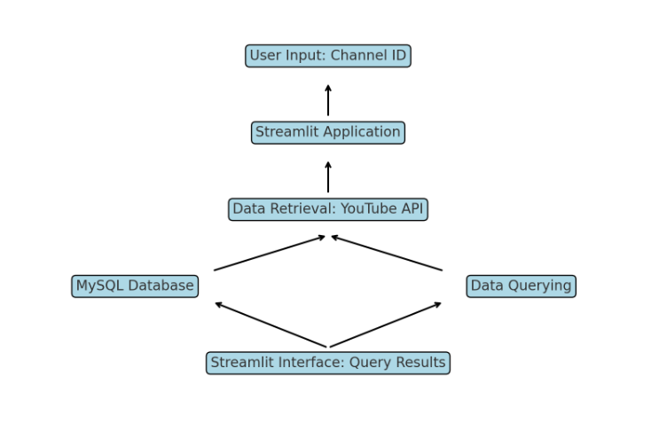
System Architecture

Slide 6
Data Warehousing with MySQL
Database Schema Overview
Channel Table: This table stores the basic information about each YouTube channel, including the channel's unique ID, name, type, total views, description, and status.
Playlist Table: This table links to the Channel table and stores information about the playlists associated with each channel. Each playlist is identified by a unique playlist ID.
Video Table: The Video table is connected to the Playlist table and holds detailed information about each video within a playlist. This includes the video's unique ID, name, description, published date, view counts, like and dislike counts, and other metadata.
Comment Table: This table is linked to the Video table and stores the comments made on each video. It includes the comment's unique ID, text, author, and the date it was published.

Slide 7
Final Thoughts
The project was a valuable learning experience, providing hands-on practice with APIs, database management, and user interface design. It reinforced the importance of integrating different technologies to create a cohesive and functional system.

Slide 8
Thank You

